Slide 1
Paper Presentation
achieve0410@gmail.com

Slide 2
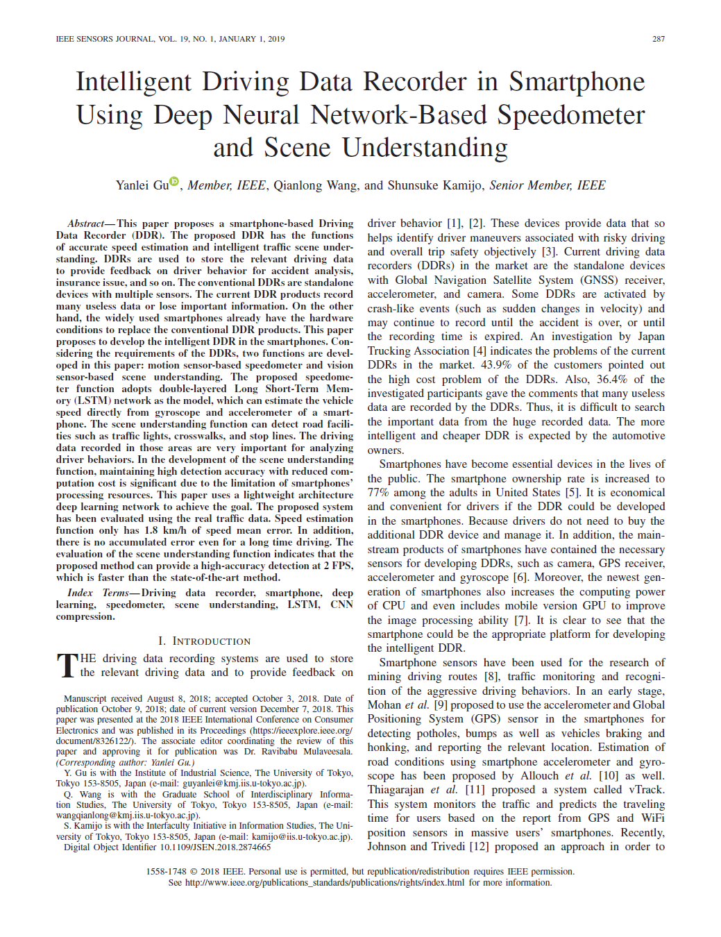
Intelligent Driving Data Recorder in Smartphone Using Deep Neural Network-Based Speedometer and Scene Understanding

Slide 3
Context
Context
Introduction
Speed estimation from gyroscope and accelerometer
Road facility detection
Experimental results
Conclusions and future work

Slide 4
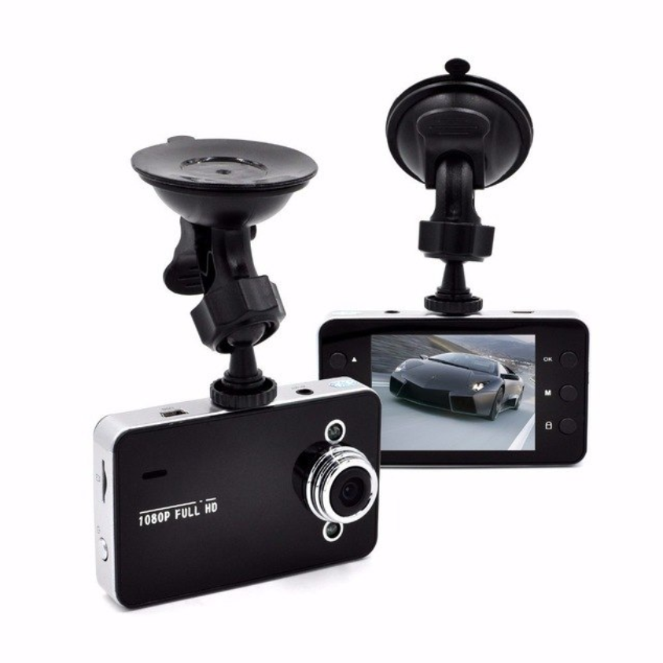
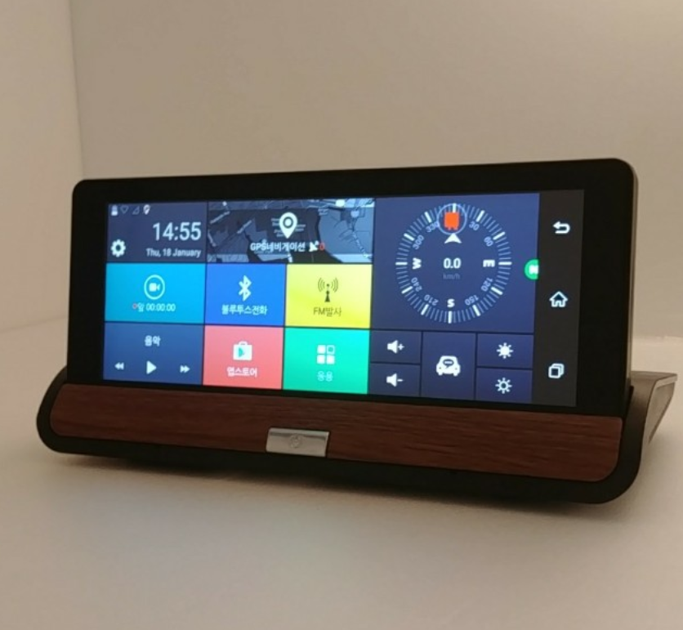
Ⅰ. Introduction
The driving data recording system are used to store
relevant driving data and provide feedback on driver behavior.
Current DDRs have
Global Navigation Satellite System(GNSS) receiver
Accelerometer
Camera

Slide 5
Ⅰ. Introduction
DDR’s problems
High cost
Lots of useless data
Solution
Using Smartphone
Essential devices in the lives – High ownership rate(77%)
Contained the necessary sensors for developing DDRs
such as camera, GPS receiver, accelerometer, gyroscope
Increases the computing power of CPU, GPU

Slide 6
Ⅰ. Introduction
Significant information for analyzing the driving behaviors
Position
Acceleration
Angle rate
Speed information
Why speed information is important?
Road speed limits are legally used in most countries
The risk of being involved in an accident as a result of excess speed

Slide 7
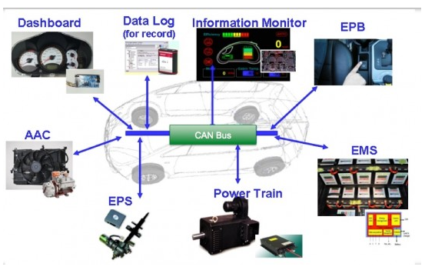
Ⅰ. Introduction
Several ways to obtain the speed information
CAN(Control Area Network)
Needs to develop the specific interface hardware for accessing to CAN data
Needs to Consider compatibility
GNSS(Global Navigation Satellite System)
Multipath reflection and blockage of GPS signal
Decrease the accuracy of the speed estimation
Can be lost in certain areas( e.g. city with tall buildings or under bridges )
Other methods should be developed as the supplement

Slide 8
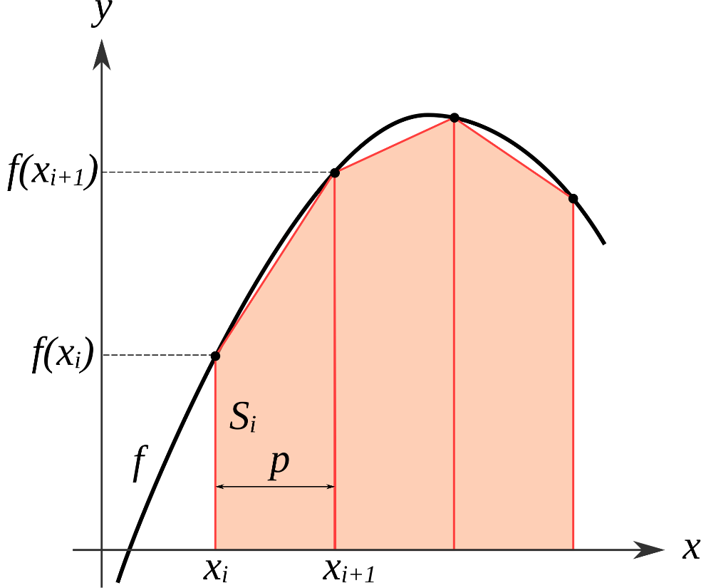
Ⅰ. Introduction
Instead of CAN and GNSS
Estimated by accelerometer in the vehicle
Integrating the data from accelerometer using the trapezoidal method
High accuracy at row speeds and short distance
but error accumulation may happen for the long distances
Estimated by accelerometer and gyroscope in the smartphone
Reset the estimated speed when such situations happen like stopping
Integrated for detecting reference situations and estimating speed
Not robust

Slide 9
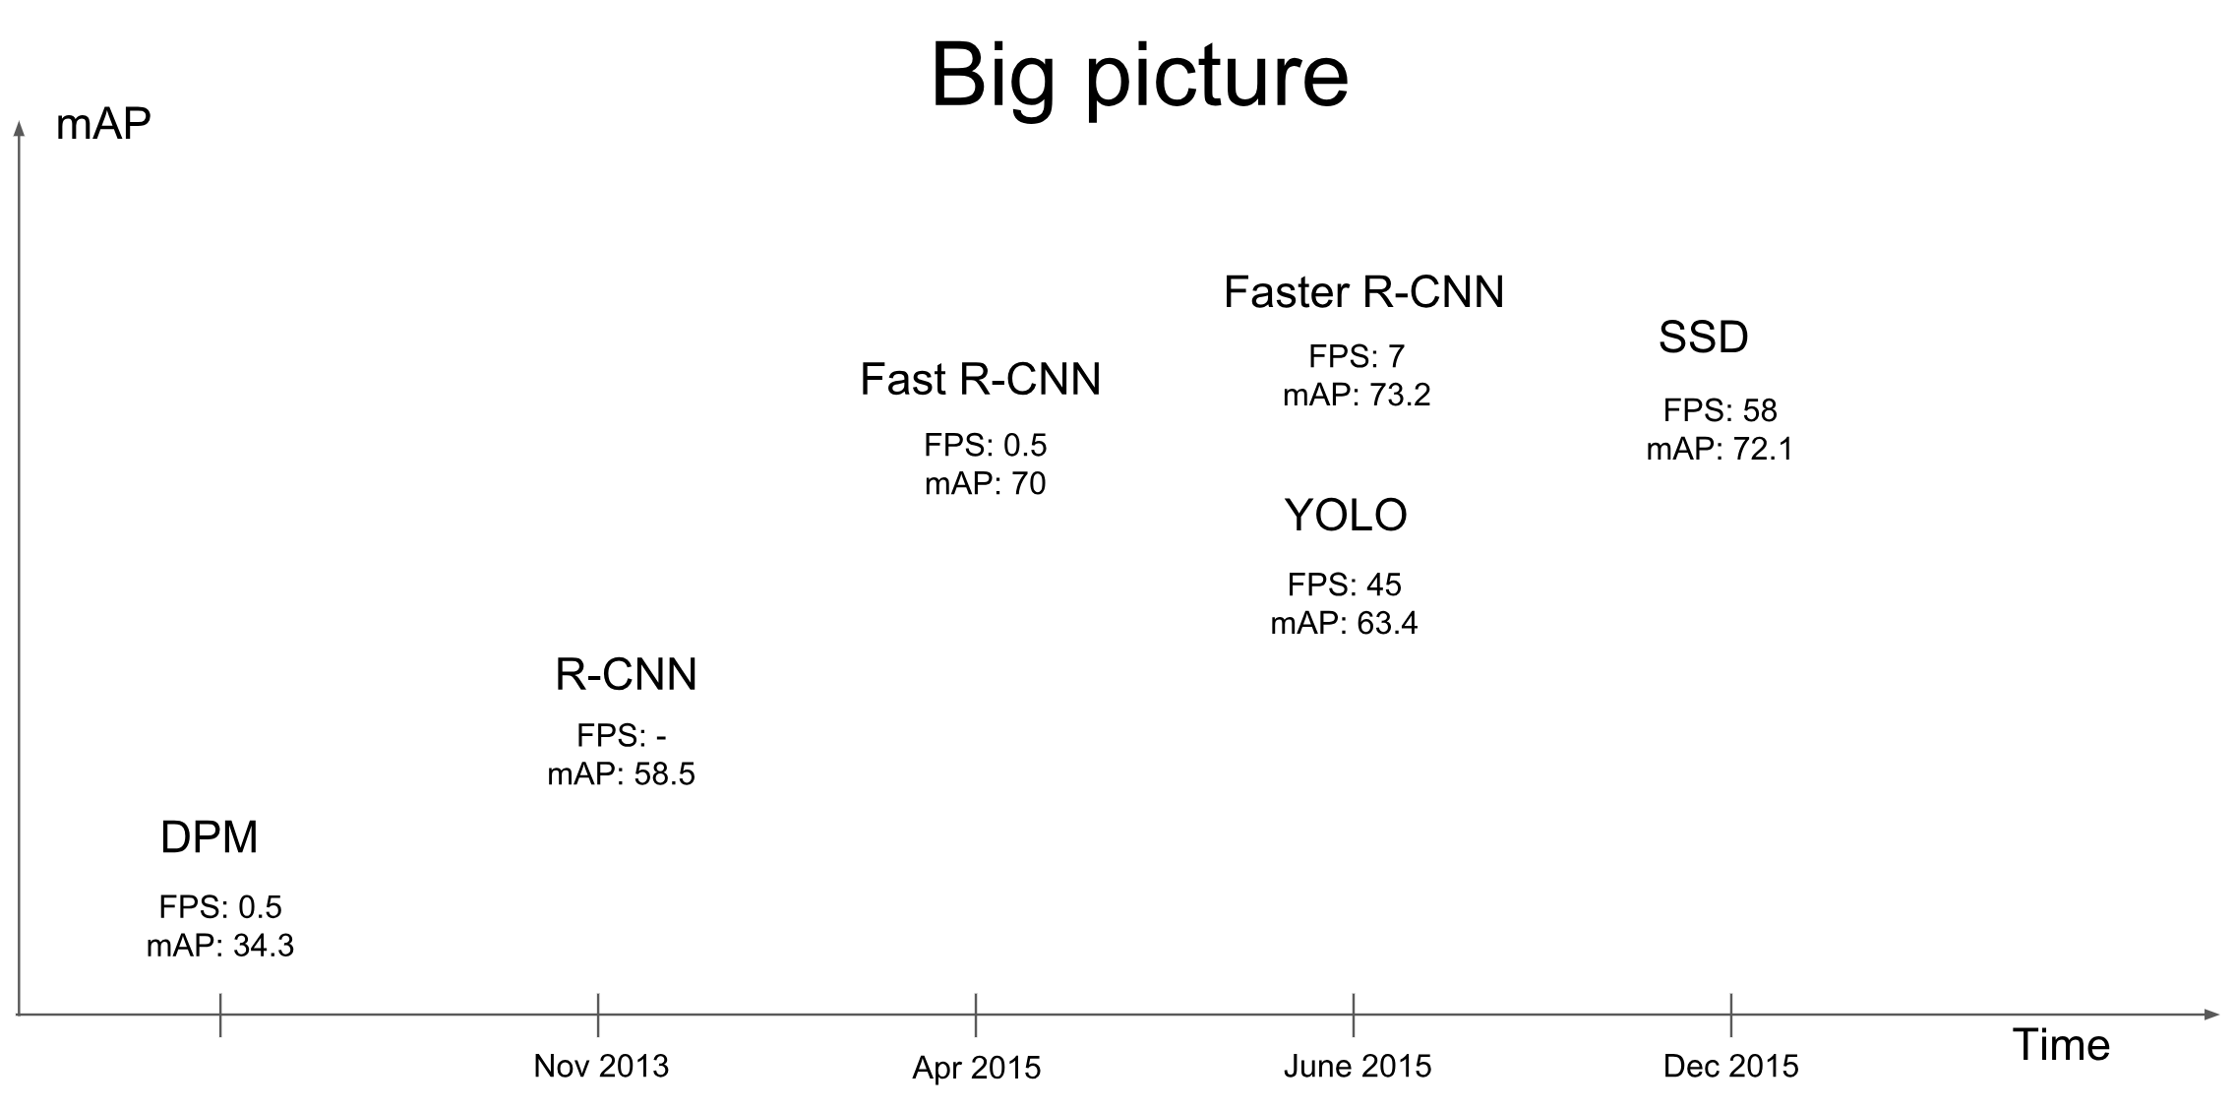
Ⅰ. Introduction
Vision based object detection
Detection of road facilities and objects in traffic scene
Using Convolutional neural network (CNN)
R-CNN, Fast R-CNN, Faster R-CNN, YOLO, SSD
Unable to achieve an acceptable processing time on the smartphone

Slide 10
Ⅰ. Introduction
Summary
Using Deep learning based speed estimation method
Using Lightweight architecture CNN

Slide 11
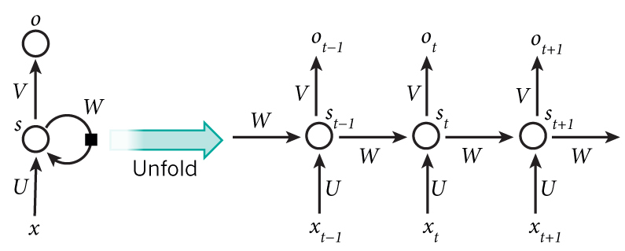
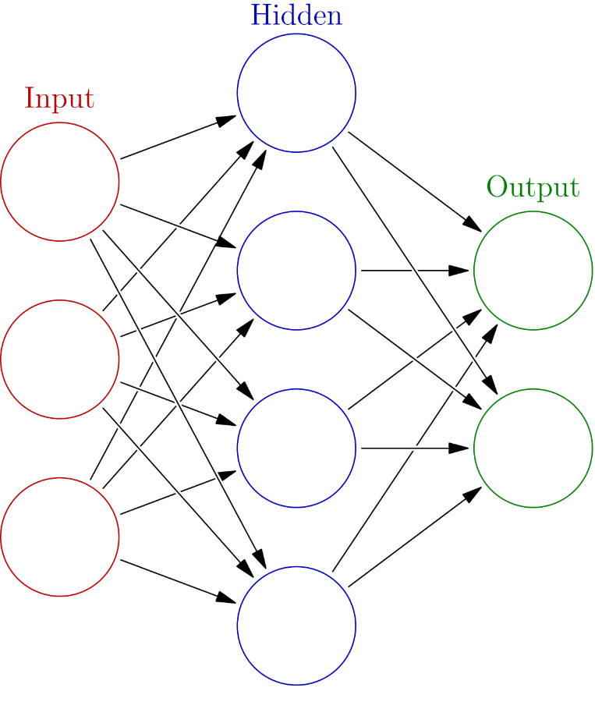
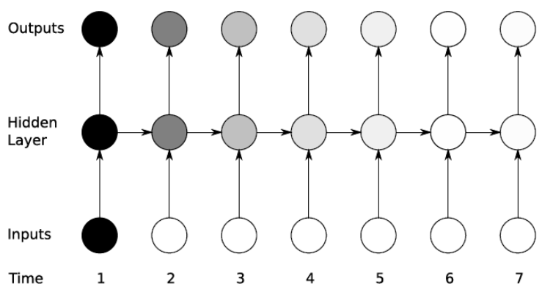
Ⅱ. Speed estimation from gyroscope and accelerometer
RNN( Recurrent neural networks )
Modeling for sequence data
Vanishing Gradient Problem
3*5 + 2*1 + 1*6
5
23
3
1
2
6
1

Slide 12
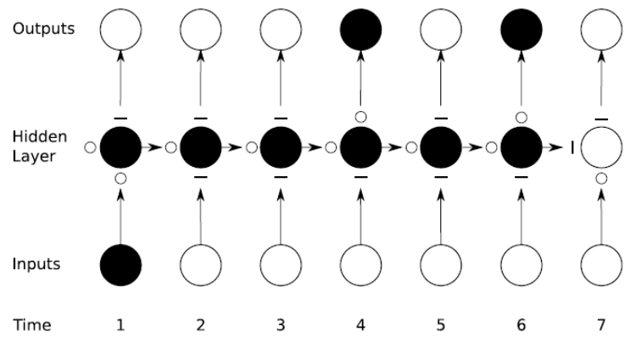
Ⅱ. Speed estimation from gyroscope and accelerometer
LSTM Network ( Long Short-Term Memory )
Recurrent neural networks(=RNN) equipped with a special gating mechanism
Output gate
Each gate has the value between 0 and 1
=> Adjust influence
Forget gate
Input gate

Slide 13
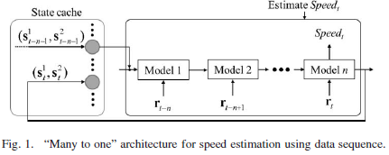
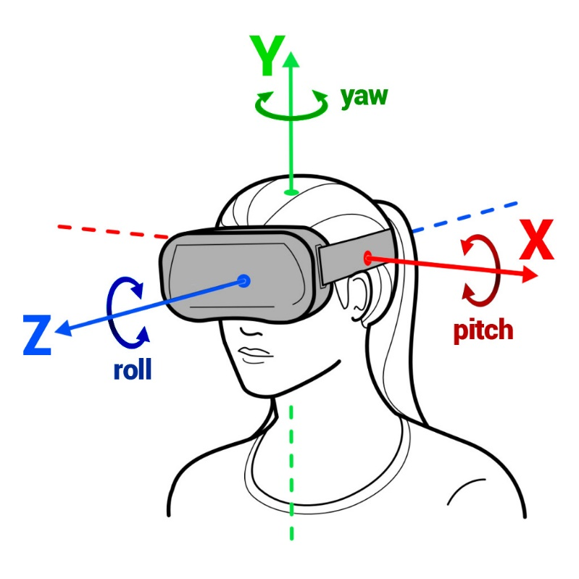
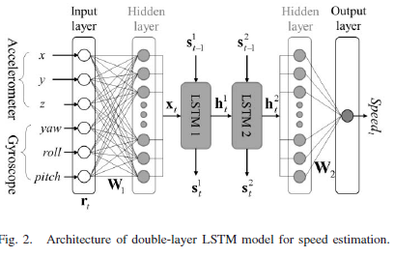
Ⅱ. Speed estimation from gyroscope and accelerometer
Concatenated Double-Layered LSTM for Speed Estimation
Two considered point
How to build the correspondence between the sequence data and estimated speed

Slide 14
Ⅱ. Speed estimation from gyroscope and accelerometer
Concatenated Double-Layered LSTM for Speed Estimation
Features of raw data
( In this paper, 128ea )

Slide 15
Ⅲ. Road facility detection
CNN(Convolutional neural network)
For object detection
Well-known deep CNN based detection algorithm
Faster R-CNN
YOLO
SSD
Depth-wise separable convolution

Slide 16
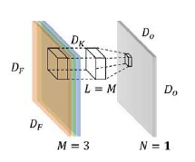
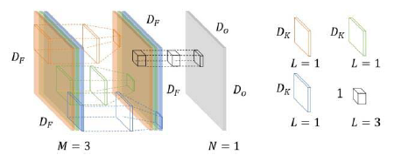
Ⅲ. Road facility detection
Standard convolution VS Depth-wise separable convolution
Computational complexity
depth-wise convolution
pointwise convolution
Computational complexity
ratio

Slide 17
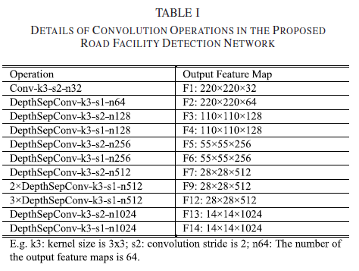
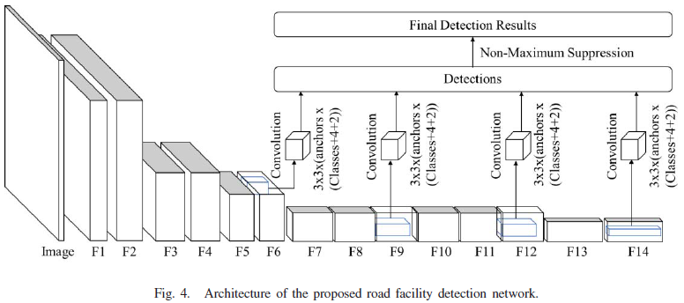
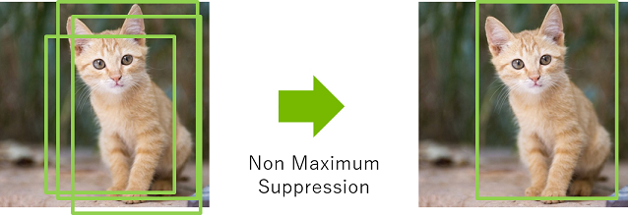
Ⅲ. Road facility detection
Light and Multiscale detection network
Primary structure is mainly inspired by SSD
Using depth-wise separable convolution
instead of the standard convolution
Fixed-size collection of bounding boxes
Non-Maximum suppression step

Slide 18
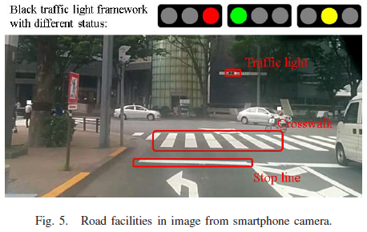
Ⅲ. Road facility detection
Light and Multiscale detection network
Problem
The sizes of detected objects differ
traffic light, crosswalk
Solution : Multiscale feature maps
The shapes of detected objects differ
Solution : Defines the several default boxes with different aspect ratios
Other deeper layer;
for crosswalk
Shallow layers; for traffic lights

Slide 19
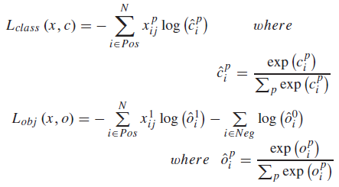
Ⅲ. Road facility detection
New loss function
SSD’s loss
proposed loss
used to detect
road facilities from the background
used to recognize
the difference among the road facilities

Slide 20
Ⅳ. Experimental results
Acceleration and angular velocity : Motion sensor in smartphone
Images : Camera in smartphone
Evaluation : GNSS receiver and CAN data recorder

Slide 21
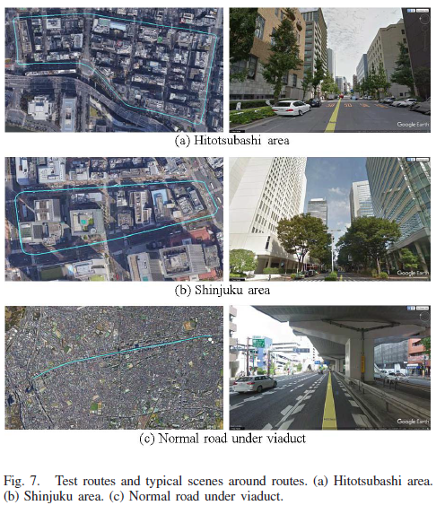
Ⅳ. Experimental results
Evaluation of Speed Estimation Function
Used about 50-hours driving data
45-hours in urban area, 5-hours in National Highway
Three different locations
Hitotsubashi, 5km
Shinjuku, 10km
Normal road under viaduct
in Tokyo, 20km

Slide 22
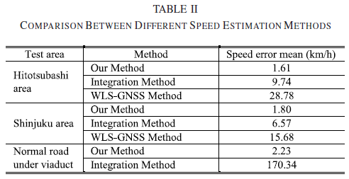
Ⅳ. Experimental results
Evaluation of Speed Estimation Function
Result
* WLS-GNSS : Weighted Least Squares GNSS
* Integration Method : proposed by Fazeen et al.

Slide 23
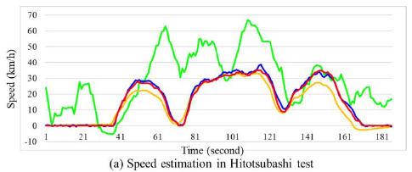
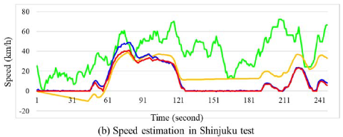
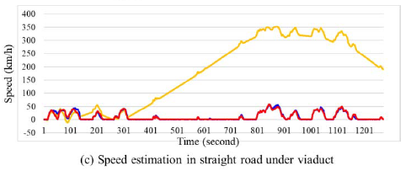
Ⅳ. Experimental results
Evaluation of Speed Estimation Function
WLS-GNSS has the huge error
: signal blockage and reflection
Integration method shows the error accumulation problem
: especially for the long distance

Slide 24
Ⅳ. Experimental results
Evaluation of Road Facility Detection
Focus on the road facilities of intersection areas
traffic light, stop line, crosswalk
For developing the road facility detection function
Label 70 image sequences for training and test
Follow PASCAL protocol to evaluate the proposed detection network
Considered as correct when overlap region
between detection and ground truth is over than 50%

Slide 25
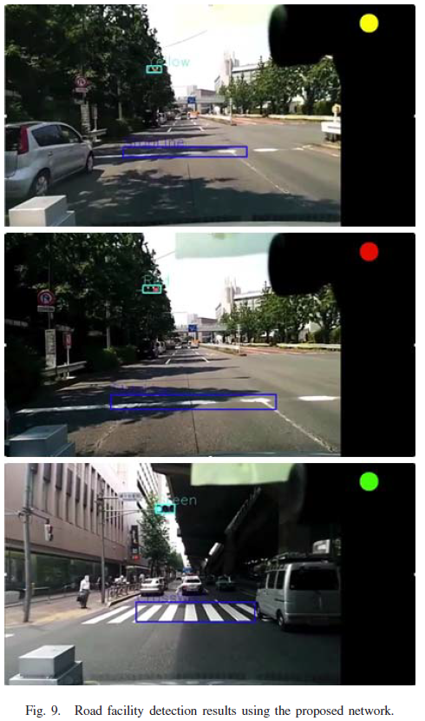
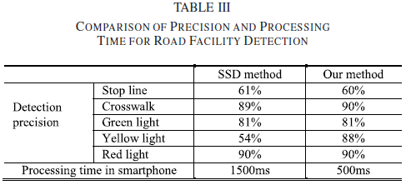
Ⅳ. Experimental results
Evaluation of Road Facility Detection
Result
Can achieve 2FPS in the smartphone

Slide 26
Ⅴ. Conclusions and future work
Conclusion
Consists of two parts
Using LSTM neural network based model to estimate vehicle speed
Using CNN to detect traffic lights, crosswalks, stop lines
In the future, dynamic object detection will be included

