Slide 1
Weekly Report
achieve0410@gmail.com

Slide 2
Context
Last week
Read Paper (Chen, Yiping, et al. "DBNet: A Large-Scale Dataset for Driving Behavior Learning.“)
Apply for a USC program
This week

Slide 3
DBNet: A Large-Scale Dataset for Driving Behavior Learning
Context
Introduction
Related Work
Dataset
Experimental Evaluation
Conclusion and Future Work

Slide 4
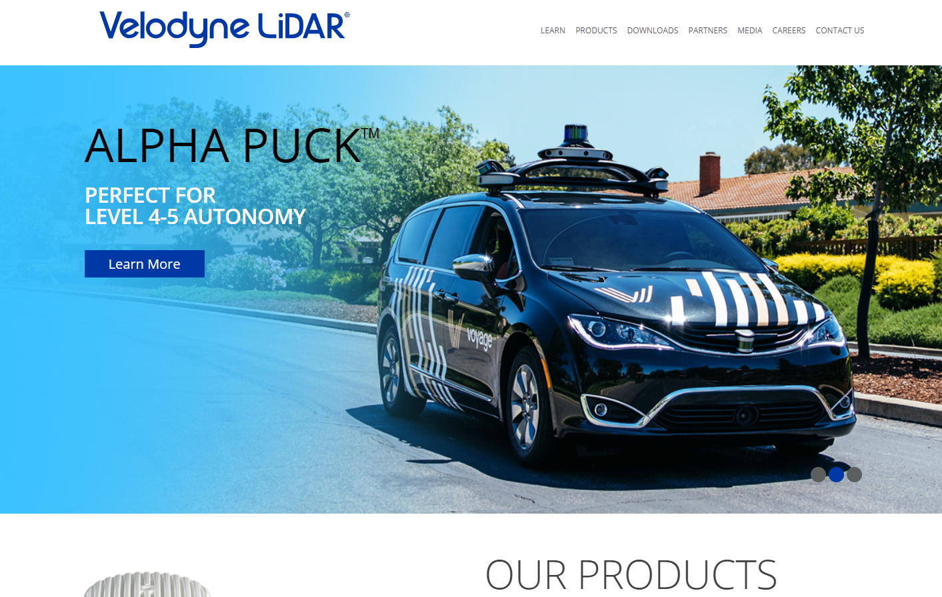
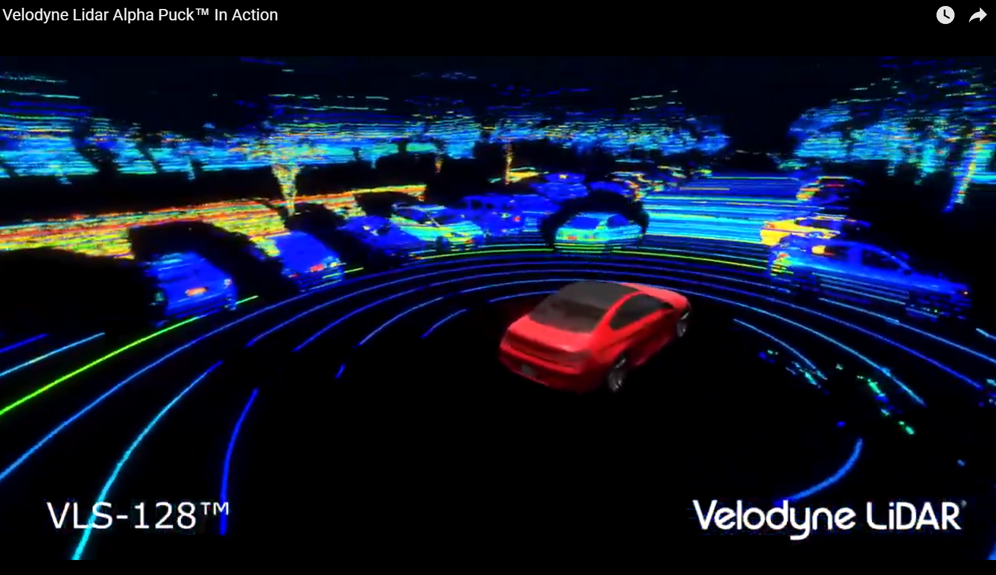
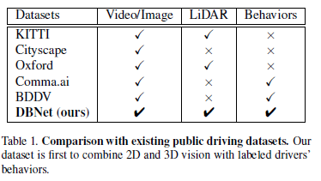
DBNet: A Large-Scale Dataset for Driving Behavior Learning
Introduction
Driving policy learning
Depth information - monocular drivers
Needs
Differences from previous dataset
Advatages
Large-scale : Exceeds 1TB
Diversity : load conditions, various objects
High-quality : high-resolution

Slide 5
DBNet: A Large-Scale Dataset for Driving Behavior Learning
Related Work
Driving Policy Learning
End-to-End learning
: mapping pixels directly to policies, NVIDIA
Learning affordable rules
: learned some affordable information in advance
which is helpful for decision making, depth information
Existing Driving Dataset
Comma.ai, KITTI, Cityscapes, Oxford, BDDV

Slide 6
DBNet: A Large-Scale Dataset for Driving Behavior Learning
Dataset
Platform and Data Collection
Data Preprocessing
Data Structure
Features and Statistics

Slide 7
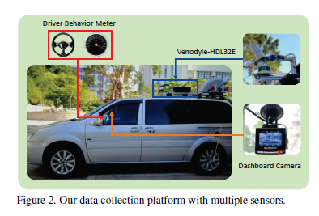
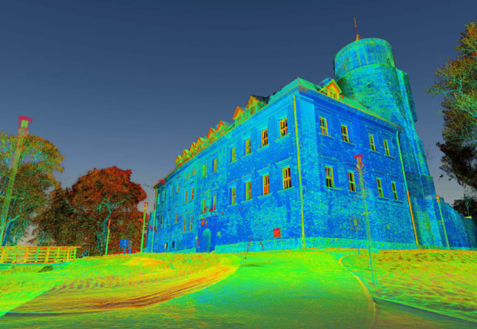
DBNet: A Large-Scale Dataset for Driving Behavior Learning
Dataset - Platform and Data Collection
Point Clouds - LiDAR seonsor
Videos
Driving behaviors
LiDAR : Light Detection And Ranging

Slide 8
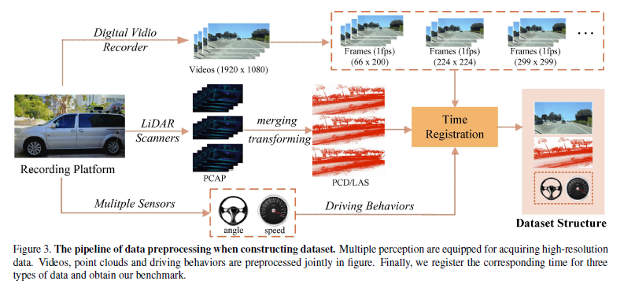
DBNet: A Large-Scale Dataset for Driving Behavior Learning
Dataset - Data Preprocessing
Only for point clouds
Frames Fusion
: captures small part of real scene -> represents one video frame
-> one pare of driving behaviors -> one scenario, around 600 scenes
-> By fusion algorithm, stored PCD format and transform to LAS format
Synchronization
Addressing Errors

Slide 9
DBNet: A Large-Scale Dataset for Driving Behavior Learning
Dataset - Data Structure
Combined with 2D and 3D information

Slide 10
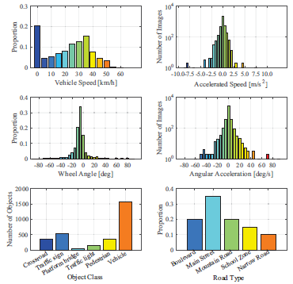
DBNet: A Large-Scale Dataset for Driving Behavior Learning
Dataset - Features and Statistics
Scale : Two times larger than KITTI
Diversity : Various traffic conditions
Quality : Depth range(70m)/Resolution(2cm)/34,000 points per second

Slide 11
DBNet: A Large-Scale Dataset for Driving Behavior Learning
Experimental Evaluation
Tasks
Evaluation Metric
Representative Approaches
Details of Training
Result
Discussion

Slide 12
DBNet: A Large-Scale Dataset for Driving Behavior Learning
Experimental Evaluation - Tasks
Discrete action prediction : Classification task(straight, stop, left, right turn)
Continuous prediction : Regression task(wheel angle, vehicle speed)

Slide 13
DBNet: A Large-Scale Dataset for Driving Behavior Learning
Experimental Evaluation - Evaluation Metric
Previous evaluation metrics - Perplexity metric, not effective
Accuracy metric
Threshold

Slide 14
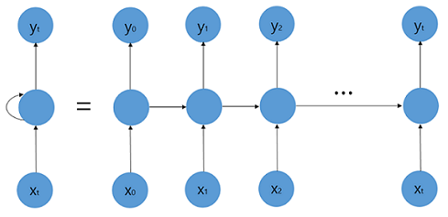
DBNet: A Large-Scale Dataset for Driving Behavior Learning
Experimental Evaluation - Representative Approaches
Learning Tools
DNN
Approaches for extracting image features (Resnet, Inception-v4)
NVIDIA - much smaller than networks but has tested well in real practice
LSTM (Long Short-Term Memory)
One of the famous RNN(Recurrent neural network)
State-of-the-art frameworks for predicting driving behaviors
For video classification
< structure of RNN >

Slide 15
DBNet: A Large-Scale Dataset for Driving Behavior Learning
Experimental Evaluation - Representative Approaches
Depth Representation
Point Cloud Mapping( = PCM)
PointNet( = PN)
: Utilizing disordered point clouds -> output the representation features

Slide 16
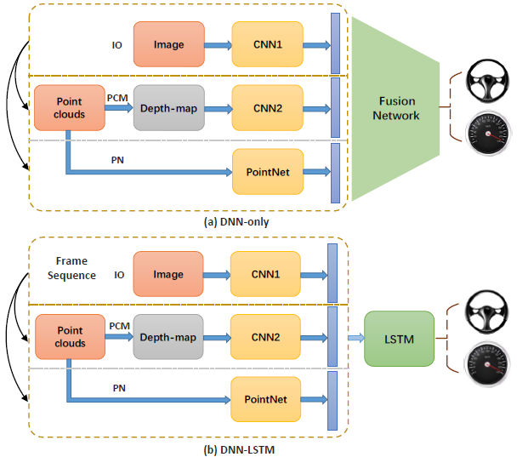
DBNet: A Large-Scale Dataset for Driving Behavior Learning
Experimental Evaluation - Representative Approaches
Two mainstream Frameworks
DNN-only
DNN-LSTM

Slide 17
DBNet: A Large-Scale Dataset for Driving Behavior Learning
Experimental Evaluation - Details of Training
Loss objective : RMSD(Root-Mean-Square Deviation, =RMSE)
Train:Test = 8:2
Optimizer : Adam

Slide 18
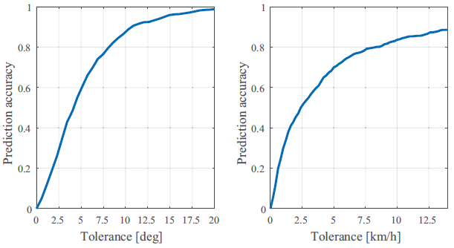
DBNet: A Large-Scale Dataset for Driving Behavior Learning
Experimental Evaluation – Result
Threshold
Vehicle speed : 5km/h
Steering angle : 6$°$

Slide 19
DBNet: A Large-Scale Dataset for Driving Behavior Learning
Experimental Evaluation – Discussion
1. Temporally sequential model keeps more essential information and get better Result
2. Depth information contributes to more reliable result
3. Not enough result of using DNN like Resnet
4. Unlimited possibility of depth information

Slide 20
DBNet: A Large-Scale Dataset for Driving Behavior Learning
Conclusion and Future Work
Importance of Depth information
End-to-End
Too expensive -> Segment point clouds in weakly-supervised/unsupervised way

